Slide 1
1. Introduction to Visual Basic
Microsoft Visual Basic is the fastest and easiest way to create applications for Microsoft windows.
visual basic provides you with a complete set of tools to simplify application development such as easy to use, user friendliness, faster application development, internet features and active X technology.

Slide 2
1.1 Event Driven Programming
Visual basic is an event driven programming language.
An event is an action performed by user, and applications that handle those events are called Event Driven Application.
Event driven programming is the most important feature of visual basic.

Slide 3
Event-driven applications execute Basic code in response to an event.
Each form and control in visual basic has a predefined set of events, like mouse click, key press, button click etc.
In procedural application developed using C and other procedure oriented programming language execution start from first line (or main function) of code

Slide 4
The “Visual” part visual basic refers to the method used to create the graphical user interface (GUI).
The “Basic” part refers to the BASIC (Beginners All-Purpose Symbolic Instruction Code) language, a language used by more programmers than any other language in the history of computing.

Slide 5
Visual Basic has evolved from the original BASIC language and now contains several hundred statements, functions, and keywords, many of which relate directly to the windows GUI.
The Visual Basic programming system, application Edition included in Microsoft Excel, Microsoft Access, and many other Windows applications uses the same language.

Slide 6
1.2 Understanding VB environment
The working environment in Visual Basic is often referred to as the Integrated Development Environment or IDE.
Because It integrates many different functions such as design ,design ,editing ,compiling ,and debugging within a common environment.

Slide 7
To start Visual Basic from windows go through --
Click Start>Programs>Microsoft Visual Studio>Microsoft Visual Basic 6.0.
Use the windows explorer to find My Computer to find the Visual Basic executable file.
3) Double click the Visual Basic icon if available on desktop.

Slide 8
Integrated Development Environment Elements
The visual Basic integrated development environment(IDE) consists of the following elements.

Slide 9
Elements of IDE:-
Menu Bar
Tool Bar
Project Explorer
Toolbox
Property Window
Form Layout Window
Object Browser
Form Designer
Code Editor Window
Immediate, locals, and watch Windows

Slide 10
1] Menu Bar
Displays the commands you use to work with Visual Basic.
Besides the standard file, Edit, view, Window, and Help menus, menus are provided to access functions specific to programming such as Project, Format, or debug.

Slide 11
Menu Bar
File
Edit
View
Project
Format
Debug
Query
Diagram
Tools
Add-Ins
Window
Help

Slide 12
2] Toolbars
click a button on the toolbar once to carry out the action represented by that button.
By default, the standard toolbar is displayed when you start a Visual Basic.
Additional toolbars for editing, form design and debugging can be opened.

Slide 13
Toolbar
The above fig. shows the standard toolbar.
The toolbar gives quick access to commonly used commands in the menu bar.
The toolbar displayed below the menu bar
The Visual Basic provides additional toolbars for specific purpose such as Edit toolbar, Debug toolbar, Form editor toolbar.

Slide 14
3] Project Explorer
Lists the forms and modules in your current project.
A project is the collection of files you use to build an application

Slide 15
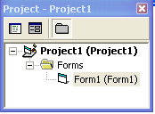
Project explorer
The window which contains the titled project is the Project Explorer.
The project explorer window displays all the project components in a hierarchical order.
It displays project and all the forms in it, class modules as well as MDI forms.

Slide 16
Toolbox
The toolbox contains different controls these controls are as follows:-
Pointer
Picture box
Label
Textbox
Frame
Command button
Check box
Option button
Combo box
List box
Scroll bars
Timer
Drive list box
Dirlistbox
File list box
Data control
Provides a set of tools that you use at design time to place controls on a form.

Slide 17
5] Properties Window
Lists the property settings for the selected form or control.
A property is a characteristic of an object, such as size, caption, or color.

Slide 18
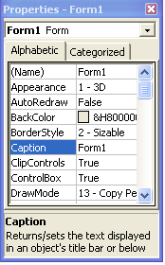
Property window
The property window contains the properties of selected control.
Properties means attributes of any object such as its name, size, color .
The common properties for all the controls are name, caption, backcolor, enable, visible, appearance etc.

Slide 19
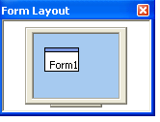
The form layout window
The form layout window determines the initial position of the forms in your application using a small graphical representation of the screen.
The form layout window default present in the lower right corner of the IDE.

Slide 20
7] Object Browser
Lists objects available for use in your project and gives you a quick way to navigate through your code.
8] Form Designer
A window that is used to design the interface of your application .You add controls, graphics, and pictures to a form.
Each form in your application has its own form designer window.

Slide 21
9] Code Editor Window
A window used for entering application code.
A separate code editor window is created for each form or code module in your application.

Slide 22
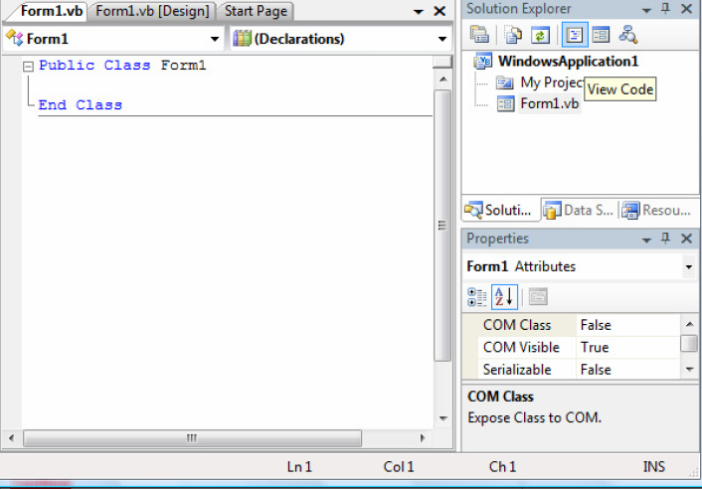
Code Window
Where the codes for forms, events and methods are written, displayed and modified

Slide 23
11] Immediate, locals, and watch Windows
These additional Windows are provided for use in debugging your application .
They are only available when you are running your application within the IDE.

Slide 24
The Anatomy of Forms

Slide 25
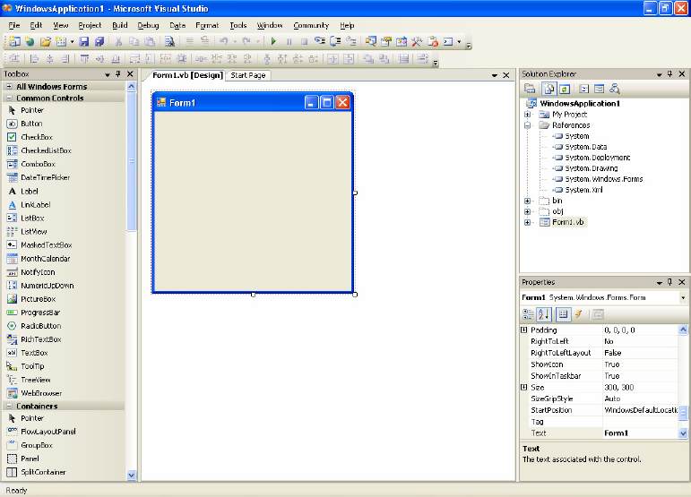

Slide 26
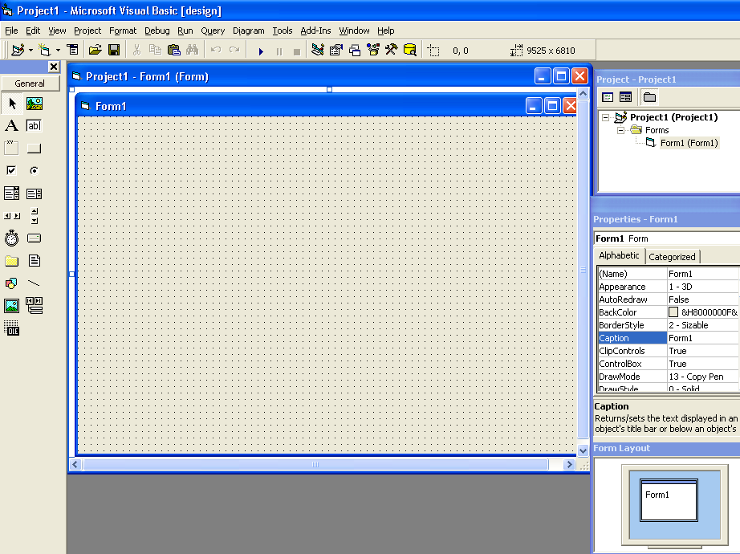

Slide 27
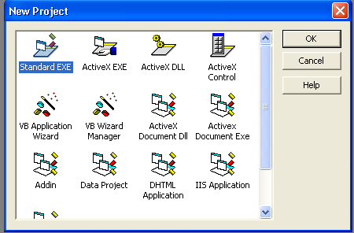
Project Types:--
Standard EXE
ActiveX EXE
ActiveX DLL
ActiveX control
Data Project
IIS Application
ActiveX Document DLL
ActiveX Document EXE
DHTML Application

